Slide 1
Network Layer
Flooding
Flooding
Distance Vector Protocol

Slide 2
Network Layer
Flooding
It is a static algorithm is flooding, in which every incoming packet is sent out on every outgoing line except the one it arrived on.
Flooding generates vast numbers of duplicate packets,, an infinite number unless some measures are taken to damp the process.
One such measure is to have a hop counter contained in the header of each packet, which is decremented at each hop, with the packet being discarded when the counter reaches zero.
Ideally, the hop counter should be initialized to the length of the path from source to destination. If the sender does not know how long the path is, it can initialize the counter to the worst case, namely, the full diameter of the subnet.

Slide 3
Network Layer
Flooding
It is a static algorithm is flooding, in which every incoming packet is sent out on every outgoing line except the one it arrived on.
Flooding generates vast numbers of duplicate packets,, an infinite number unless some measures are taken to damp the process.
One such measure is to have a hop counter contained in the header of each packet, which is decremented at each hop, with the packet being discarded when the counter reaches zero.
Ideally, the hop counter should be initialized to the length of the path from source to destination. If the sender does not know how long the path is, it can initialize the counter to the worst case, namely, the full diameter of the subnet.

Slide 4
Network Layer
Routing Protocol
Distance Vector Protocol
Link state protocol
Path Vector Protocol

Slide 5
Network Layer
Distance Vector Protocol
In distance vector routing, the least-cost route between any two nodes is the route
with minimum distance. In this protocol, as the name implies, each node maintains a vector (table) of minimum distances to every node.
The table at each node also guides the packets to the desired node by showing the next stop in the route (next-hop routing).

Slide 6
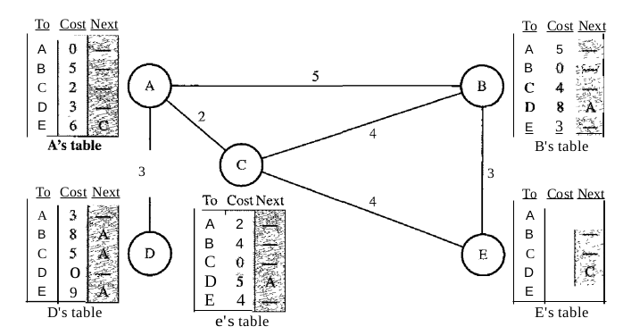
Network Layer
Distance Vector Routing Table

Slide 7
Network Layer
Initialization :- The tables in previous Figure are stable; each node knows how to reach any other node and the cost. At the beginning, however, this is not the case. Each node can know only the distance between itself and its immediate neighbors, those directly connected to it.
So for the moment, we assume that each node can send a message to the immediate neighbors and find the distance between itself and these neighbors.
Initially tables at A,B,C,D,E
A | 0
B | 5
C | 2
D | 3
E | ∞
A | 5
B | 0
C | 4
D | ∞
E | 3
A | 2
B | 4
C | 0
D | ∞
E | 4
A | 3
B | ∞
C | ∞
D | 0
E | ∞
A | ∞
B | 3
C | 4
D | ∞
E | 0

Slide 8
Network Layer
Sharing :-The whole idea of distance vector routing is the sharing of information between neighbors. Although node A does not know about node E, node C does. So if node C shares its routing table with A, node A can also know how to reach node E.
On the other hand,node C does not know how to reach node D, but node A does. If node A shares its routing table with node C, node C also knows how to reach node D. In other words, nodes A and C, as immediate neighbors, can improve their routing tables if they help each other.
There is only one problem. How much of the table must be shared with each neighbor? A node is not aware of a neighbor's table. The best solution for each node is to send its entire table to the neighbor and let the neighbor decide what part to use and what part to discard. However, the third column of a table (next stop) is not useful for the neighbor. When the neighbor receives a table, this column needs to be replaced with the sender's name. If any of the rows can be used, the next node is the sender of the table. A node therefore can send only the first two columns of its table to any neighbor. In other words, sharing here means sharing only the first two columns.

Slide 9
Network Layer
Updating :-
When a node receives a two-column table from a neighbor, it needs to update its routing table. Updating takes three steps:
1. The receiving node needs to add the cost between itself and the sending node to each value in the second column. The logic is clear. If node C claims that its distance to a destination is x mi, and the distance between A and C is y mi, then the distance between A and that destination, via C, is x + y mi.
2. The receiving node needs to add the name of the sending node to each row as the third column if the receiving node uses information from any row. The sending node is the next node in the route.
3. The receiving node needs to compare each row of its old table with the corresponding row of the modified version of the received table.
a. If the next-node entry is different, the receiving node chooses the row with the smaller cost. If there is a tie, the old one is kept.
b. If the next-node entry is the same, the receiving node chooses the new row. For example, suppose node C has previously advertised a route to node X with distance 3. Suppose that now there is no path between C and X; node C now advertises this route with a distance of infinity. Node A must not ignore this value even though its old entry is smaller. The old route does not exist any more. The new route has a distance of infinity.

Slide 10
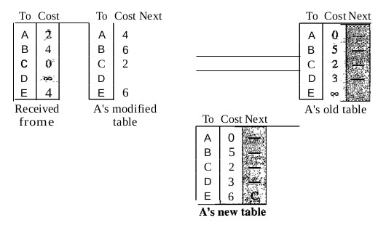
Network Layer
Updating :-

Slide 11
Network Layer
When to Share :-
The question now is, When does a node send its partial routing table (only two columns) to all its immediate neighbors? The table is sent both periodically and when there is a change in the table.
Periodic Update:- A node sends its routing table, normally every 30 s, in a periodic update. The period depends on the protocol that is using distance vector routing.
Triggered Update:- A node sends its two-column routing table to its neighbors anytime there is a change in its routing table. This is called a triggered update. The change can result from the following.
1. A node receives a table from a neighbor, resulting in changes in its own table after updating.
2. A node detects some failure in the neighboring links which results in a distance change to infinity.

Slide 12
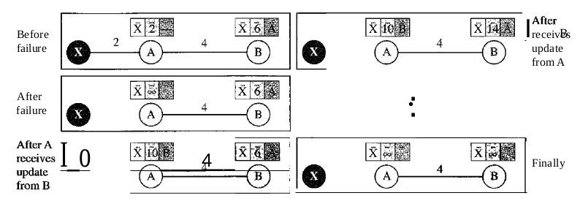
Network Layer
Two-Node Loop Instability:-A problem with distance vector routing is instability, which means that a network using this protocol can become unstable.

Slide 13
Network Layer
Two-Node Loop Instability:-
Previous Figure shows a system with three nodes. We have shown only the portions of the routing table needed for our discussion. At the beginning, both nodes A and B know how to reach node X. But suddenly, the link between A and X fails. Node A changes its table.
If A can send its table to B immediately, everything is fine. However, the system becomes unstable if B sends its routing table to A before receiving A's routing table. Node A receives the update and, assuming that B has found a way to reach X, immediately updates its routing table. Based on the triggered update strategy, A sends its new update to B. Now B thinks that something has been changed around A and updates its routing table. The cost of reaching X increases gradually until it reaches infinity.
At this moment, both A and B know that X cannot be reached. However, during this time the system is not stable. Node A thinks that the route to X is via B; node B thinks that the route to X is via A. If A receives a packet destined for X, it goes to B and then comes back to A. Similarly, if B receives a packet destined for X, it goes to A and comes back to B. Packets bounce between A and B, creating a two-node loop problem.

Slide 14
Network Layer
Two-Node Loop Instability:-
A few solutions have been proposed for instability of this kind.
Defining Infinity The first obvious solution is to redefine infinity to a smaller number, such as 100. For our previous scenario, the system will be stable in less than 20 updates. As a matter of fact, most implementations of the distance vector protocol define the distance between each node to be I and define 16 as infinity. However, this means that the distance vector routing cannot be used in large systems. The size of the network, in each direction, can not exceed 15 hops.
Split Horizon Another solution is called split horizon. In this strategy, instead of flooding the table through each interface, each node sends only part of its table through each interface. If, according to its table, node B thinks that the optimum route to reach X is via A, it does not need to advertise this piece of information to A; the information has corne from A (A already knows). Taking information from node A, modifying it, and sending it back to node A creates the confusion. In our scenario, node B eliminates the last line of its routing table before it sends it to A. In this case, node A keeps the value of infinity as the distance to X. Later when node A sends its routing table to B, node B also corrects its routing table. The system becomes stable after the first update: both node A and B know that X is not reachable.

Slide 15
Network Layer
Two-Node Loop Instability:-
Split Horizon and Poison Reverse Using the split horizon strategy has one drawback. Normally, the distance vector protocol uses a timer, and if there is no news about a route, the node deletes the route from its table. When node B in the previous scenario eliminates the route to X from its advertisement to A, node A cannot guess that this is due to the split horizon strategy (the source of information was A) or because B has not received any news about X recently.
The split horizon strategy can be combined with the poison reverse strategy. Node B can still advertise the value for X, but if the source of information is A, it can replace the distance with infinity as a warning: "Do not use this value; what I know about this route comes from you."

Slide 16
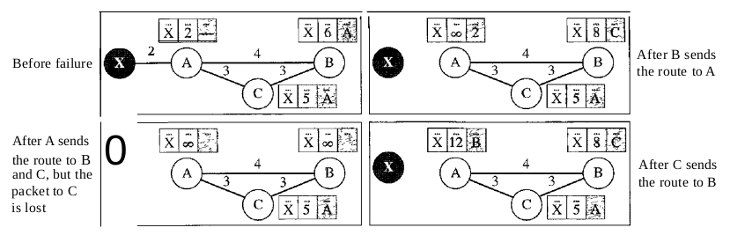
Network Layer
Three-Node Instability:-
The two-node instability can be avoided by using the split horizon strategy combined with poison reverse. However, if the instability is between three nodes, stability cannot be guaranteed.

Slide 17
Network Layer
Three-Node Instability:-
In previous diagram, suppose after finding that X is not reachable, node A sends a packet to Band C to inform them of the situation. Node B immediately updates its table, but the packet to C is lost in the network and never reaches C. Node C remains in the dark and still thinks that there is a route to X via A with a distance of 5. After a while, node C sends to Bits routing table, which includes the route to X. Node B is totally fooled here. It receives information on the route to X from C, and according to the algorithm, it updates its table, showing the route to X via C with a cost of 8.
This information has come from C, not from A, so after awhile node B may advertise this route to A. Now A is fooled and updates its table to show that A can reach X via B with a cost of 12. Of course, the loop continues; now A advertises the route to X to C, with increased cost, but not to B.
Node C then advertises the route to B with an increased cost. Node B does the same to A. And so on. The loop stops when the cost in each node reaches infinity.

